Slide 1
The Use of Bandit Algorithms in Intelligent Interactive Recommender Systems
Intern: Qing Wang 6/6/2018

Slide 2
Outline
Introduction
Research Problems
Online Context-aware Recommendation with Time-varying Multi-armed Bandit
Dynamical Context Drift Model
Online Context-based recommendation Using Hierarchical Multi-armed Bandit
Hierarchical Multi-armed Bandit Model
Online Interactive Collaborative Filtering Using Multi-armed Bandit with Dependent Arms
Interactive Collaborative Topic Regression Model

Slide 3










Introduction
Interactive recommender systems:
Promptly feed users the interesting items (e.g., news, movies);
Adaptively optimize the underlying model using the up-to-date feedback ( );
Ultimate Goal: continuously maximize user satisfaction in a long run.
Notes:
A monitoring ticket generated from problem servers

Slide 4
A General Process of Interactive Recommendation
Interaction
Data
Profiling
Problem Profiles
User Preference
Preference
Drift
User/Item
Dependence
Research Problems:
Learn user preference
Track preference drift
Learn and use user/item dependence
Recommendation
Algorithms
Contextual Multi-armed Bandits
Interactive Collaborative Filtering
Notes:
Recommendation algorithms are required to learn a good mapping function between user preferences and items.

Slide 5
Outline
Introduction
Research Problems
Online Context-aware Recommendation with Time-varying Multi-armed Bandit
Dynamical Context Drift Model
Online Context-based recommendation Using Hierarchical Multi-armed Bandit
Hierarchical Multi-armed Bandit Model
Online Interactive Collaborative Filtering Using Multi-armed Bandit with Dependent Arms
Interactive Collaborative Topic Regression Model

Slide 6
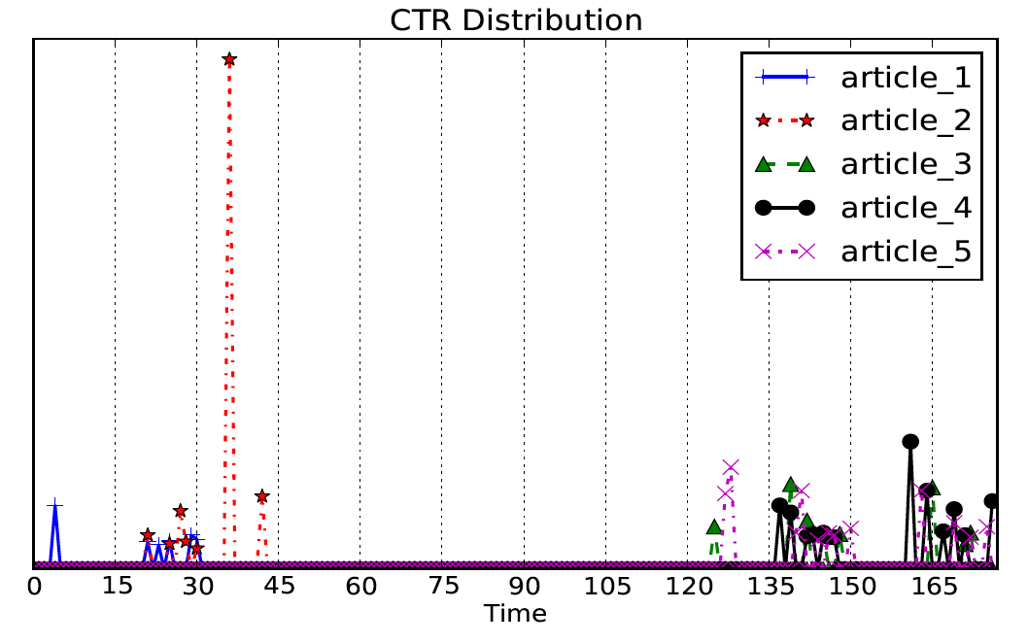
Online Context-aware Recommendation with Time-varying Multi-armed Bandit
Example:
Given the same contextual information for each article, the average CTR distribution of five news articles from Yahoo! news repository is displayed. The CTR is aggregated by every hour.
Challenge: How do we promptly capture both of the varying popularity of item content and the
evolving customer preferences over time, and further utilize them for recommendation improvement?

Slide 7
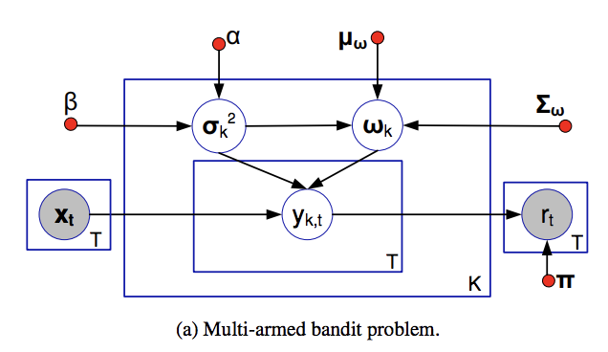
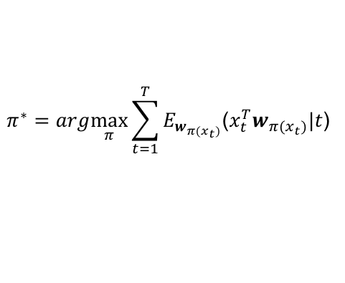
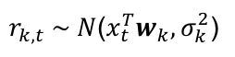
Contextual Multi-armed Bandit Algorithm
The reward $r_{k,t}$ is typically modeled as a linear combination of the feature vector $x_{t}$ with coefficient vector $w_{k}$, given at time $t=[1,…,T]$ as follows:
$r_{k,t} \sim N$($x_{t}^{T}w_{k}, σ_{k}^{2}$)
The optimal policy $π^{∗}$ is defined as the one with maximum accumulated expected reward after T iterations:
$$π^{∗}=arg\max_{π}{\sum_{t=1}^{T}{E_{w_{π(x_{t})}}\text{(}x_{t}^{T}w_{{π(x}_{t})}|t\text{) }}}$$
Notes:
Existing relevant research studies for contextual multi-armed bandit problems often assume the existence of a fixed yet unknown reward mapping function.

Slide 8
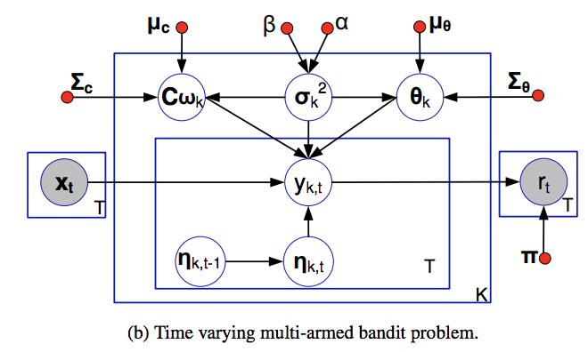
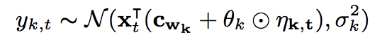
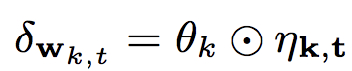

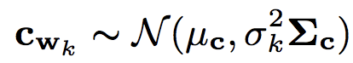
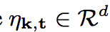
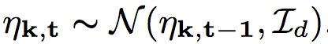
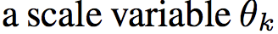
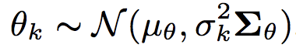
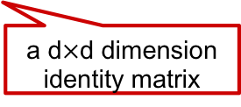
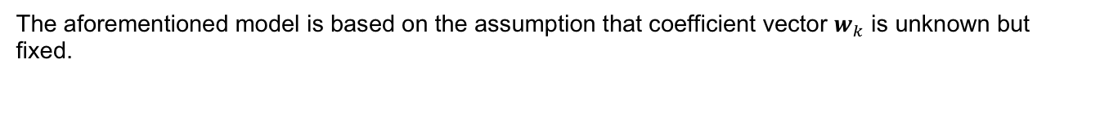
Dynamic Context Drift Modeling
The aforementioned model is based on the assumption that coefficient vector $w_{k}$ is unknown but fixed.
The drift component
The stationary component
a d$×$d dimension identity matrix

Slide 9
Dynamic Context Drift Modeling
The reward $y_{k,t}$ is modeled to be drawn from the following Gaussian distribution.

Slide 10
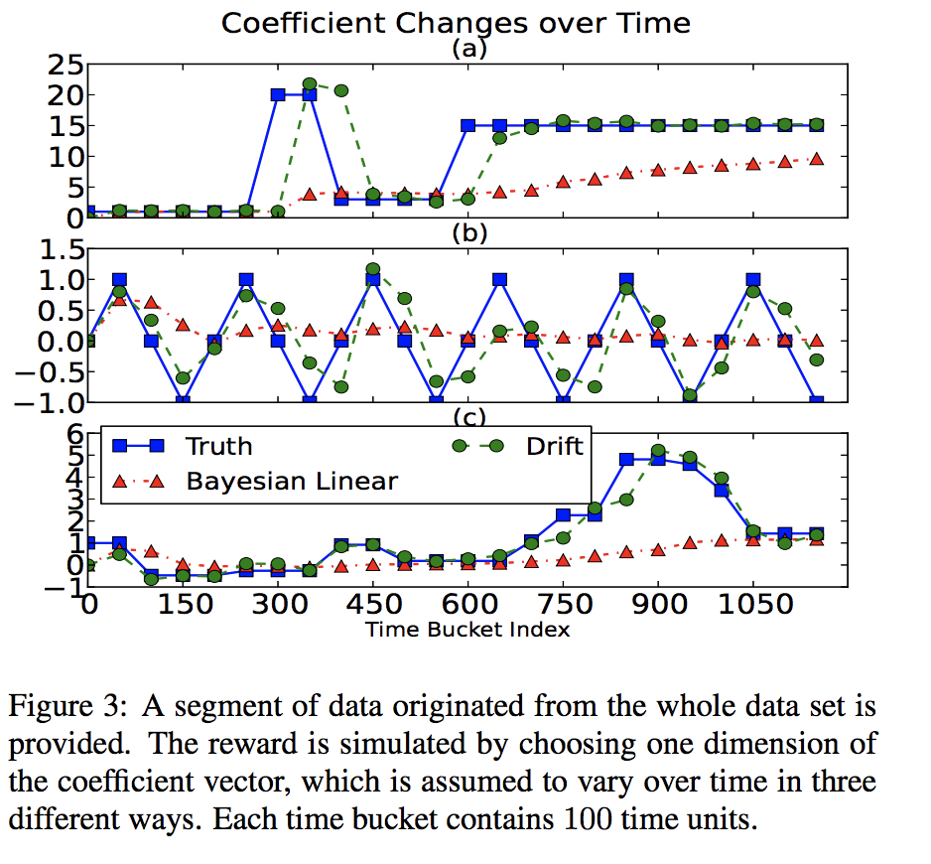
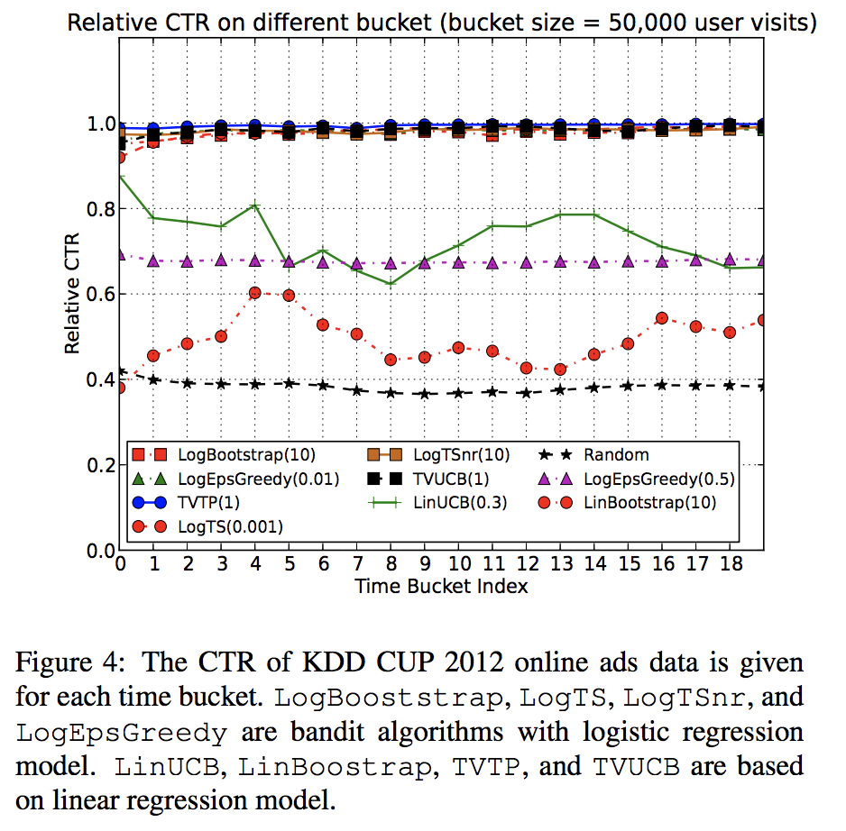
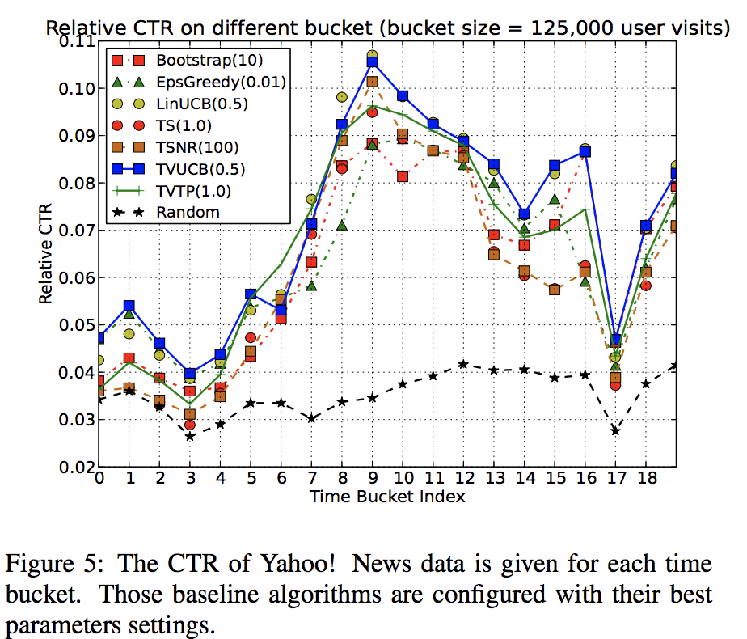
Experiments
Context Change Tracking, CTR (Click-Through Rate) Optimization
a) Dataset: KDD Cup 2012 Online Advertising, Yahoo! Today News.
b) Evaluation Method: simulation and replayer [1].
1. L. Li, W. Chu, J. Langford, T. Moon, and X. Wang. An unbiased offline evaluation of contextual bandit algorithms with generalized linear models. JMLR, 26:19-36, 2012.

Slide 11
Conclusion
Take the dynamic behavior of reward into account and model it as a random walk.
A dynamic context drift model is proposed to track the contextual dynamics and consequently improve the performance of personalized recommendation in terms of CTRs

Slide 12
Outline
Introduction
Research Problems
Online Context-aware Recommendation with Time-varying Multi-armed Bandit
Dynamical Context Drift Model
Online Context-based recommendation Using Hierarchical Multi-armed Bandit
Hierarchical Multi-armed Bandit Model
Online Interactive Collaborative Filtering Using Multi-armed Bandit with Dependent Arms
Interactive Collaborative Topic Regression Model

Slide 13


IT automation recommendation modeling
IT Automation Services (ITAS) is introduced into IT service management. An automation is a scripted resolution.
Execute an automation
Feedback (success or fail)
Problem Server I
Execute an automation
Feedback (success or fail)
Automation Engine
Rule-based Virtual Engineer
Problem Server 2
An overview of IT Automation Services
Notes:
A monitoring ticket generated from problem servers

Slide 14
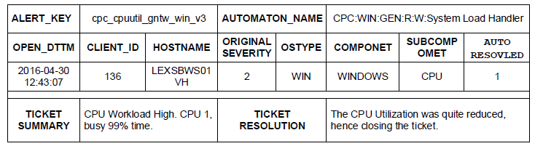
IT Automation Recommendation Modeling
feedback
A sample ticket in ITSM and its corresponding automaton.

Slide 15
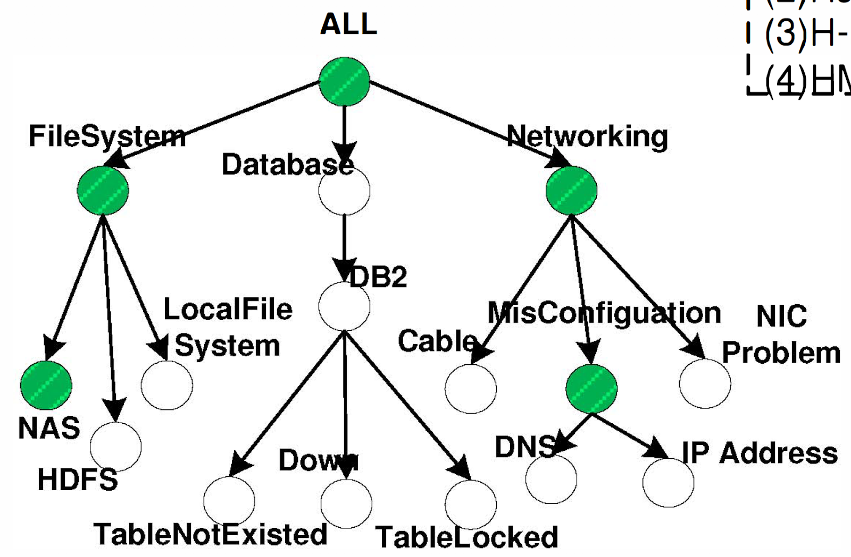
Challenge
Challenge: How do we efficiently improve the performance of recommendation using the explicit automation hierarchies of IT automation services?
For example, a ticket is generated due to a failure of the DB2 database. The root cause may be database deadlock, high usage or other issues.
We model it as a multi-armed problem with dependent arms, where arms are in the form of hierarchies.
Notes:
To the best of our knowledge, this paper is the first work to formulate the automation recommendation in IT automation services as a multi-armed bandit problem by considering the dependencies among arms in the form of hierarchies.

Slide 16
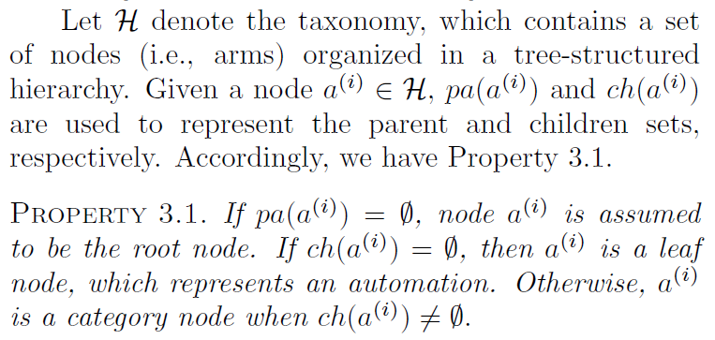
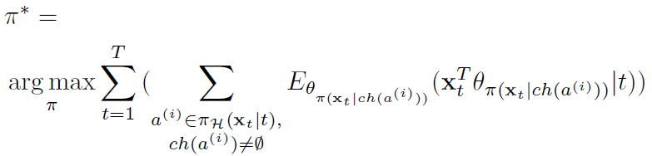
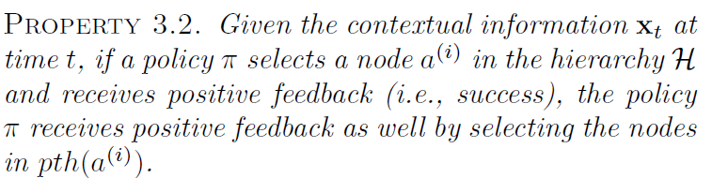
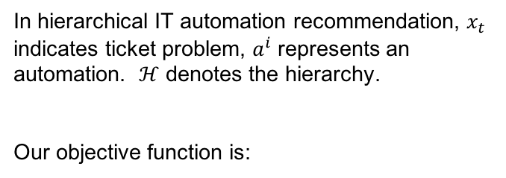
Hierarchical IT Automation Recommendation Modeling
In hierarchical IT automation recommendation, $x_{t}$ indicates ticket problem, $a^{i}$ represents an automation. $ℋ$ denotes the hierarchy.
Our objective function is:
Notes:
To the best of our knowledge, this paper is the first work to formulate the automation recommendation in IT automation services as a multi-armed bandit problem by considering the dependencies among arms in the form of hierarchies.

Slide 17
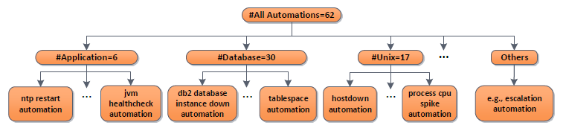
Hierarchial Multi-armed Bandit Algorithm
At time t = [1,…,T]:
Level 0
Level 1
Level 2
Notes:
Here is an example to explain how HMAB works. At each time t, according to the policy, it will choose a node until it reaches to the leaf node.

Slide 18
Hierarchial Multi-armed Bandit Algorithm
At time t = [1,…,T]:
Level 0
Level 1
Level 2
Notes:
To the best of our knowledge, this paper is the first work to formulate the automation recommendation in IT automation services as a multi-armed bandit problem by considering the dependencies among arms in the form of hierarchies.

Slide 19
Hierarchial Multi-armed Bandit Algorithm
At time t = [1,…,T]:
Level 0
Level 1
Level 2
Notes:
To the best of our knowledge, this paper is the first work to formulate the automation recommendation in IT automation services as a multi-armed bandit problem by considering the dependencies among arms in the form of hierarchies.

Slide 20
Hierarchial Multi-armed Bandit Algorithm
At time t = [1,…,T]:
Level 0
Level 1
Level 2
1 or 0
Notes:
To the best of our knowledge, this paper is the first work to formulate the automation recommendation in IT automation services as a multi-armed bandit problem by considering the dependencies among arms in the form of hierarchies.

Slide 21
Hierarchial Multi-armed Bandit Algorithm
At time t = [1,…,T]:
Level 0
Level 1
1 or 0
Level 2
Notes:
To the best of our knowledge, this paper is the first work to formulate the automation recommendation in IT automation services as a multi-armed bandit problem by considering the dependencies among arms in the form of hierarchies.

Slide 22
Hierarchial Multi-armed Bandit Algorithm
At time t = [1,…,T]:
Level 0
1 or 0
Level 1
Level 2
Notes:
To the best of our knowledge, this paper is the first work to formulate the automation recommendation in IT automation services as a multi-armed bandit problem by considering the dependencies among arms in the form of hierarchies.

Slide 23
Experiment
Data Set
Experimental tickets are collected by IBM Tivoli Monitoring system covering from July 2016 to March 2017 with the size of |D| = 116,429.
The dataset contains 1,091 alert keys (e.g., cpusum_xuxc_aix, prccpu_rlzc_std) and 62 automations (e.g., NFS automation, process CPU spike automation) in total.
A three-layer hierarchy H.
Evaluate Method
Replayer method.

Slide 24
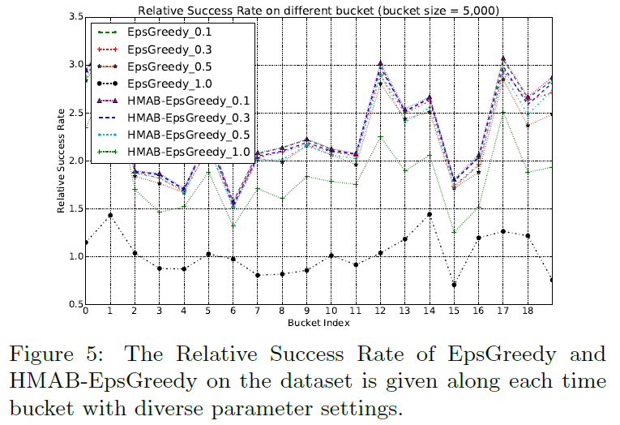
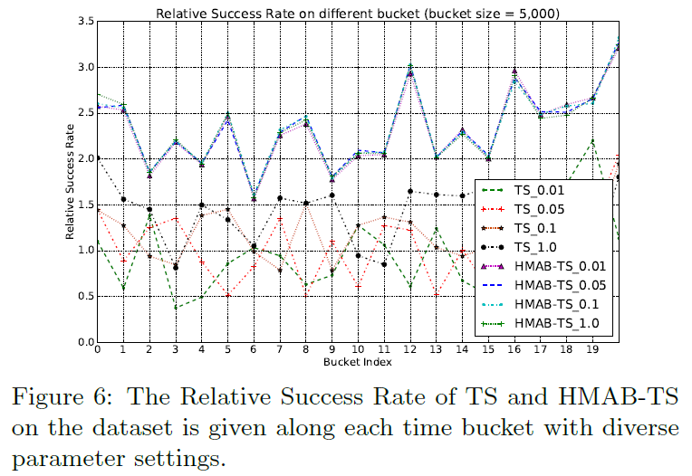
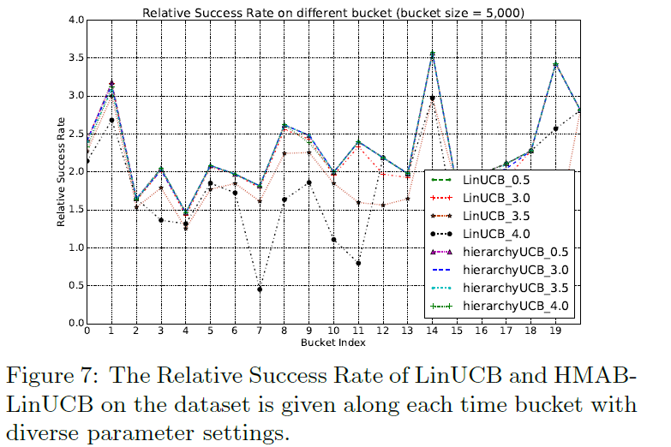
Experiment
Notes:
This is the experimental results. You can see that our proposed HMAB outperform the other baseline algorithms.

Slide 25
Conclusion
Take the hierarchical information into account and model it as a multi-armed bandit problem with dependent arms.
Propose hierarchical multi-armed bandit (HMAB) algorithms.
Notes:
This is the experimental results. You can see that our proposed HMAB outperform the other baseline algorithms.

Slide 26
Outline
Introduction
Research Problems
Online Context-aware Recommendation with Time-varying Multi-armed Bandit
Dynamical Context Drift Model
Online Context-based recommendation Using Hierarchical Multi-armed Bandit
Hierarchical Multi-armed Bandit Model
Online Interactive Collaborative Filtering Using Multi-armed Bandit with Dependent Arms
Interactive Collaborative Topic Regression Model

Slide 27
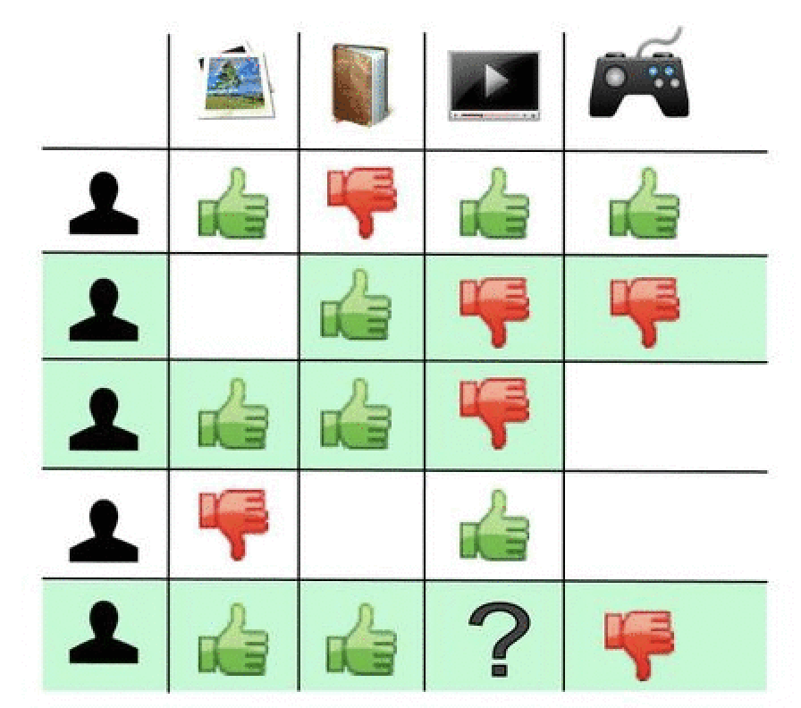
Challenge
Challenge 1: How do we effectively recommend a proper item to the target user with no contextual information of user/item, but only the users’ interaction data on items can be utilized?
This can be naturally modeled as an interactive collaborative filtering problem, which has been first introduced in [2].
2. X. Zhao, W. Zhang, and J. Wang. Interactive collaborative filtering. In CIKM, pages 1411-1420. 2013.
Notes:
Nonetheless, the assumption rarely holds in reality, since the real-world items tend to be correlated with each other (e.g., two articles with similar topics)

Slide 28
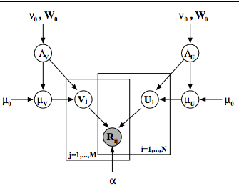
Interactive Collaborative Fitlering Problem
No context information can be observed.
Recommend an item
Feedback (rating)
Item 1
Update parameters
Collaborative Bandit Model
Item 2
…
Item N
Bayesian Probabilistic Matrix Factorization

Slide 29
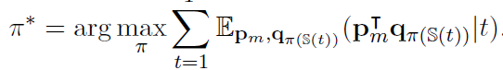
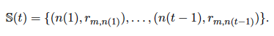

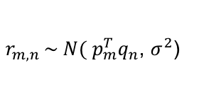
Interactive Collaborative Fitlering Problem
There are M users and N items. The partially observed matrix R is the preference of the users for the items. In the collaborative bandit model, the rating is estimated by a product of user and item feature vectors $p_{m}$ and $q_{n}$.
$r_{m,n }\sim N( p_{m}^{T}q_{n}$, $σ^{2}$)
The objective function can be written as follows:
Where$𝕊(t)$ is available information observed at time $t$.
However, these models assume the arms (i.e.) are independent.
Notes:
Nonetheless, the assumption rarely holds in reality, since the real-world items tend to be correlated with each other (e.g., two articles with similar topics)

Slide 30
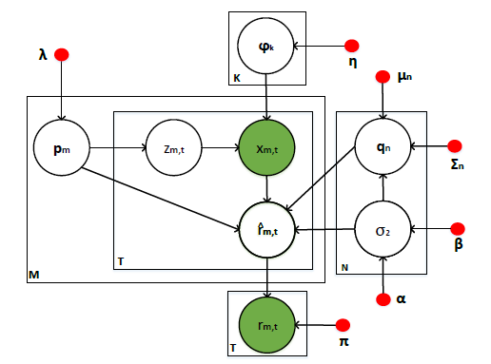
Interactive Collaborative Topic Regression Model
In light of the topic modeling techniques, we formulate the item dependencies as the clusters on arms and come up with a generative model to generate the items from their underlying topics.
document
words
User 1
item1, item q, …item n
User m
item3, item k, …item i
User x
item1, item 2, …item o
…
The graphical representation for ICTR model
Notes:
The main idea of our model is to treat an item n as a word, while consider a user m as a document.
All the items rated by a user indicate the hidden preferences of the user, analogous to the scenario in topic modeling where the words contained in a document imply its latent topics.

Slide 31
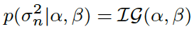
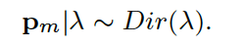
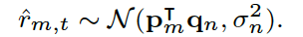
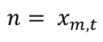

Interactive Collaborative Topic Regression Model
$$n= x_{m,t}$$
The predicted rating ${\hat{r}}_{m,t}$ can be inferred by
The graphical representation for ICTR model
Notes:
The main idea of our model is to treat an item n as a word, while consider a user m as a document.
All the items rated by a user indicate the hidden preferences of the user, analogous to the scenario
in topic modeling where the words contained in a document imply its latent topics.

Slide 32
Experiment
Data Set
Evaluate Method
Replayer method.
Data Set | Yahoo News | MovieLens (10M)
#users | 226,710 | 71,567
#items | 652 | 10,681
#ratings | 280,410,150 | 10,000,054

Slide 33
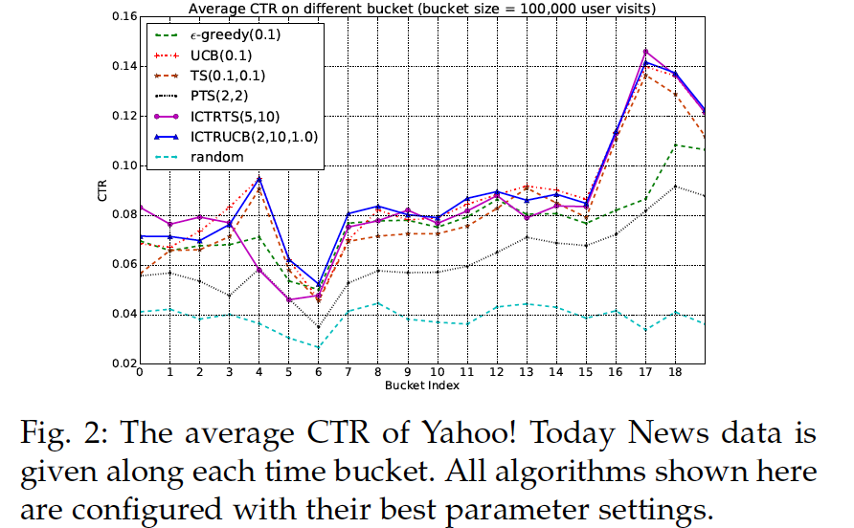
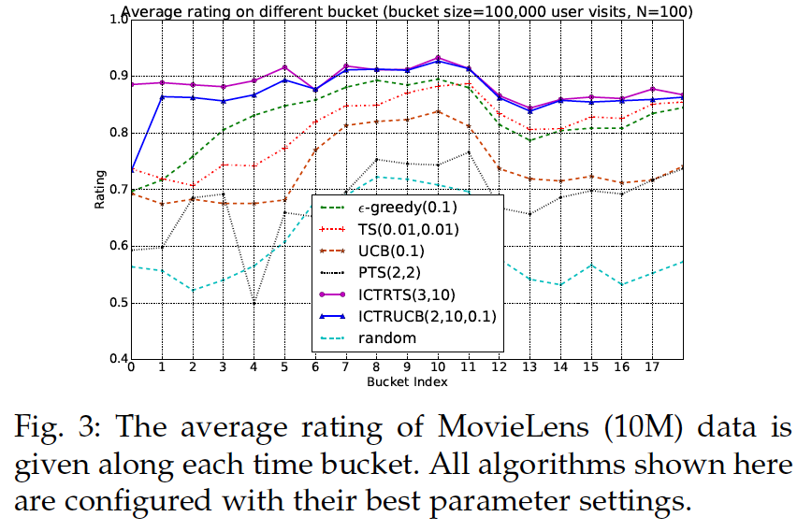
Experiment

Slide 34
Conclusion
Only user/item rating matrix is taken into account and model it as a multi-armed bandit problem with dependent arms.
Propose Interactive Collaborative Topic Regression (ICTR) model to learn the dependence among arms.

Slide 35

Q & A

Slide 36
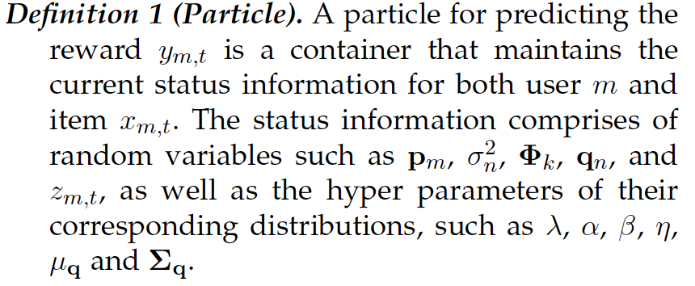
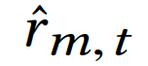
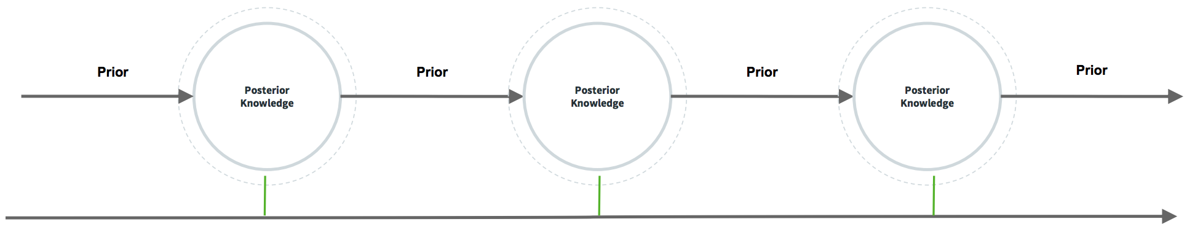
Online Inference of ICTR Model: Particle Learning

Slide 37
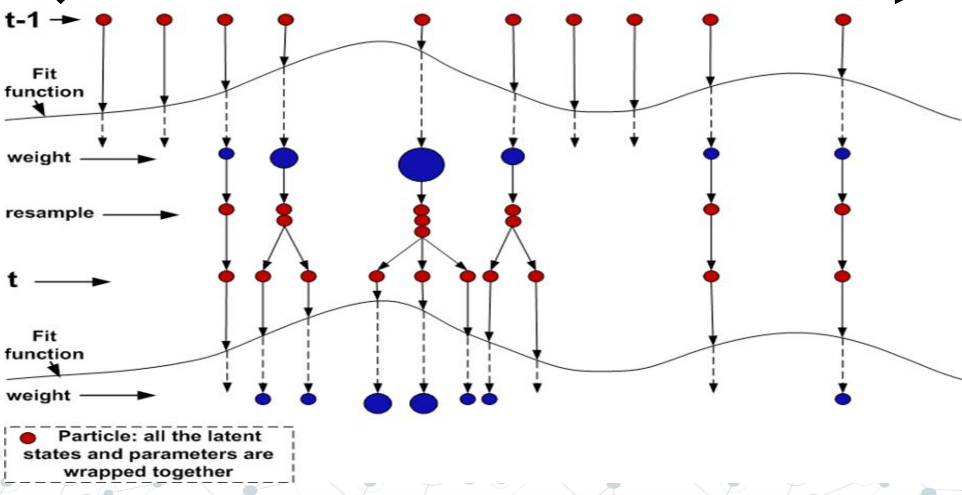
Online Inference of ICTR Model: Particle Learning

Slide 38
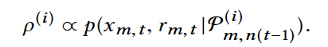
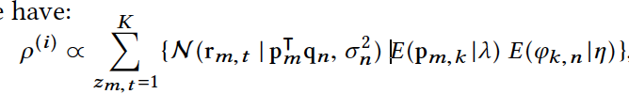
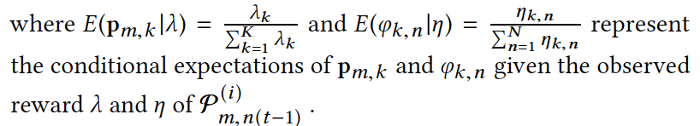
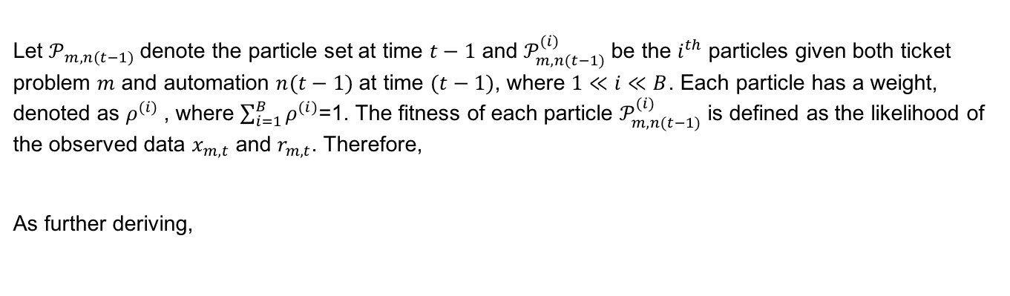
Re-sample Particles with Weights
Let $𝒫_{m,n\left(t−1\right)}$denote the particle set at time $t−1$ and $𝒫_{m,n(t−1)}^{(i)}$be the $i^{th}$ particles given both ticket problem $m$ and automation $n(t−1)$ at time $(t−1)$, where $1≪i≪B$. Each particle has a weight, denoted as $ρ^{(i)}$, where $\sum_{i=1}^{B}{ρ^{(i)}}$=1. The fitness of each particle $𝒫_{m,n(t−1)}^{(i)}$ is defined as the likelihood of the observed data $x_{m,t}$ and $r_{m,t}$. Therefore,
As further deriving,

Slide 39
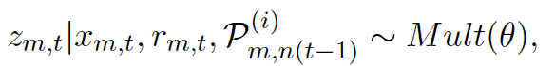
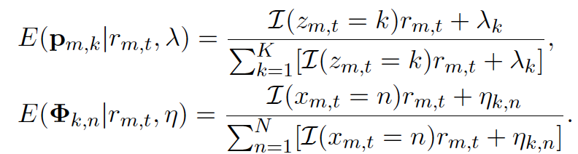
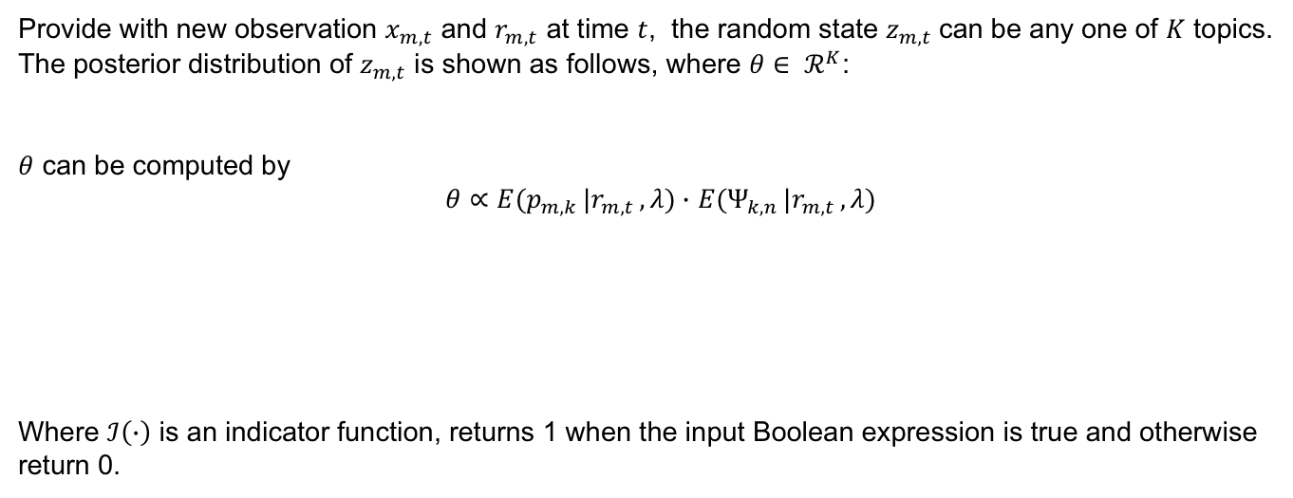
Latent State Inference
Provide with new observation $x_{m,t}$ and $r_{m,t}$ at time $t$, the random state $z_{m,t}$can be any one of $K$ topics.
The posterior distribution of $z_{m,t}$ is shown as follows, where $θ∈ ℛ^{K}$:
$θ$ can be computed by
$θ∝E(p_{m,k }|r_{m,t }, λ)∙$ $E(Ψ_{k,n }|r_{m,t }, λ)$
Where $ℐ\left(∙\right)$ is an indicator function, returns 1 when the input Boolean expression is true and otherwise return 0.

Slide 40







Parameter Statistics Inference
Assume are the sufficient statistics at time $t$, which are updated on the sufficient statistics at $t$-1, and new observation data $x_{m,t}$and $r_{m,t}$ at time $t$ as follows.
At time $t$, the sampling process for the parameter random variables is summarized as below:

Slide 41




Integrate with Policies: Thompson sampling
Without new observation $x_{m,t}$ and $r_{m,t}$, the particle re-sampling, latent state inference and parameter statistics inference for time $t$, therefore, we utilize the latent vectors $p_{m}$ and $q_{n}$ sampled from their posterior distributions at time $t$-1 predicting the reward for each arm.
In our model, each item has B independent particles. Based on Thompson sampling, the policy select an arm $n(t)$ using the following equation:
Where denotes the average reward:

Slide 42





Integrate with Policies: UCB
According to UCB policy, it select an arm $n(t)$ based on the upper bound of the predicted reward. Assuming that
the UCB is developed by the mean and variance of predicted reward.
where $γ≫0$ is a predefined threshold, and the variance is
${\overline{r}}_{m,n}$= $\frac{1}{B}\sum_{i=1}^{B}{r_{m,t}^{(i)}}$

